Slide 1
HELPING
AND HELPING PROFESSIONS
Vypracovala Lenka Tkadlčíková, listopad/2019

Slide 2
HELPING PROFESSIONS
A helping profession is defined as a professional interaction between a helping expert and a client, initiated to nurture the growth of, or address the problems of, a person’s physical, psychological, intellectual, or emotional constitution, including medicine, nursing, psychotherapy, psychological counselling, social work, education, or coaching (Graf, Sator, & Spranz-Fogasy, 2014).
Helping in and through communication as a means to solve an individual’s problem has always been the purpose of human communication and as such is inherent in its formats and characteristics: especially the goal orientation of communication and its overall purpose of solving tasks, as well as the possibility of adding another’s perspective, are central elements of helping professions (Kallmeyer, 2001; Miller and Considine, 2009).

Slide 3

HELPING PROFESSION
IS A PROFESSION THAT NURTURES THE GROWTH OF, OR ADRESSES THE PROBLEMS OF, A PERSON’S PHYSICAL, PSYCHOLOGICAL, INTELLECTUAL, EMOTIONAL, OR SPIRITUAL WELL-BEING. We can include e.g. social work, medicine, nursing, teaching, or psychotherapy.

Slide 4
QUALITIES EXPECTED OF, AND REQUIRED IN, HELPING PROFESSIONALS
EMPATHY
PATIENCE
TOLERANCE
PERSISTENCE
FLEXIBILITY
RESILIENCE
FOCUS
ATTENTION
OPENNESS

Slide 5

MOTIVATION TO CHOOSE A HELPING PROFESSION, ESPECIALLY SOCIAL WORK
I WANT/WANTED TO HELP PEOPLE

Slide 6
IT IS IMPORTANT TO HELP OTHERS
One can hardly expect to be helped if he/she refuses to help others
To build good connections with others
It makes you feel good about yourself/the feeling of self-worth
When we give to others it activates the areas of the brain associated with pleasure, social connection, and trust.
Altruistic behaviour releases endorphins in the brain and boosts happiness for us, as well as the people we help. Studies have shown that giving money away tends to make people happier than spending it on themselves.

Slide 7

WIN-WIN STRATEGY
HELPING OTHERS IS A WIN-WIN STRATEGY.
A win-win game is a game theory which is designed in such a way that all participants can profit from the game in one way or another. In conflict resolution, a win-win strategy is a collaborative strategy and conflict resolution process that aims to accommodate all participants.

Slide 8
WHAT DO SOCIAL WORKERS DO WHEN THEY HELP?
ASSIST
ADVOCATE
ENCOURAGE
MEDIATE
COUNSEL
PROVIDE INFORMATION
FACILITATE
ACCOMPANY
GUIDE
INSTRUCT
ASSESS
PLAN
DETERMINE
CONSULT
SUPPORT
INVESTIGATE
RESEARCH
REFER
RESPOND
EDUCATE
IMPROVE
DEVELOP A PLAN
SET THE GOAL
ADJUST THE PLAN
IDENTIFY (PEOPLE WHO NEED HELP)
MAKE THE CLIENT SELF-SUFFICIENT
APPLY (FOR BENEFITS)
PROTECT

Slide 9
DON’T FORGET TO HELP YOURSELF BEFORE HELPING OTHERS
If you travel by plane, you might be familiar with the following statement:
“Before you assist others, always put your own oxygen mask on first.”
What this means with regard to your career is to take care of yourself.
- you need to be relaxed, satisfied, comforted, safe, healthy, confident, organized, centred, and at peace with yourself. Only then can you be of good help to others and not be in danger of burn-out syndrome.
The most important person is the one you are right now with. And guess who that is.

Slide 10
TO HELP OR NOT TO HELP?
How come sometimes people do not help?
What do we need to be able to help? (Latane and Darley’s model, 1969)
we must notice that an emergency event has occurred
we must interpret the situation as one in which help is needed
we must assume personal responsibility
Once we feel responsibility, we must decide what action to take
Final step: have the power and courage to take action

Slide 11
Prosocial behaviour
Prosocial behaviour, or the intent to benefit others, is a social behaviour that “benefits other people or society as a whole”, “such as helping, sharing, donating, co-operating, and volunteering”. Obeying the rules and conforming to socially accepted behaviours (such as not talking in class or waiting for the green light at the traffic lights) are also regarded as prosocial behaviour.
Encouraging prosocial behaviour may also require reducing or eliminating undesirable social behaviours.
Psychologists have shown that helping others can produce “feel-good” neurotransmitters such as oxytocin and that, similarly to any other pleasurable activity, the act of volunteering, giving, and behaving pro-socially can become addictive (Keltner et al., 2014).

Slide 12
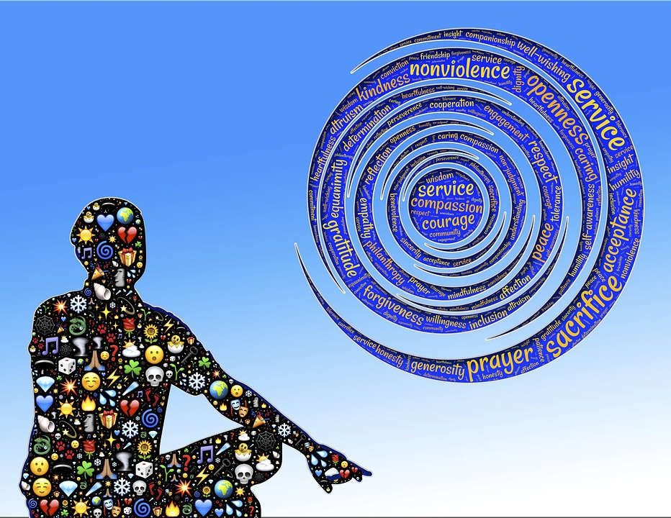
ALTRUISM
The purest forms of prosocial behaviour are motivated by ALTRUISM, an unselfish interest in helping another person.

Slide 13
References:
Graf, E. M., Sator, M., & Spranz-Fogasy, T. (2014). Discourses of helping professions. Concepts and contextualization.
Kallmeyer, W. (2001). “Beraten und Betreuen. Zur gesprächs-analytischen Untersuchung von helfenden Interaktionen.” Zeitschrift für Qualitative Bildungs, Beratungs- und Sozialforschung 2: 227-252.
Keltner, D., Kogan, A., Piff, P. K., & Saturn, S. R. (2014). The sociocultural appraisals, values, and emotions (SAVE) framework of prosociality: Core processes from gene to meme. Annual Review of Psychology, 65, 425-460.
Latane, B., & Darley, J. M. (1969). Bystander “Apathy”. American Scientist, 57(2), 244-268.

Slide 14
Reference:
Miller, K., & Considine, K. (2009). “Communication in the Helping Professions.” In The Routledge Handbook of Applied Communication Research, ed. by Lawrence Frey and Kenneth Cissna, 405-428. New York: Routledge.

Slide 15
Reference: internet sources, retrieved 9-11-2019
https://www.actionforhappiness.org/10-keys-to-happier-living/do-things-for-others
https://www.careerexplorer.com/careers/social-worker/
https://www.huffpost.com/entry/before-you-help-others-yo_b_8267004?guccounter=1&guce_referrer=aHR0cHM6Ly93d3cuZ29vZ2xlLmNvbS8&guce_referrer_sig=AQAAAAGn5eboEVAs6CJ03bcwkgHnBJ-qV0NlKfthY1iujaYUmcmBibK935Zcw2tjTvE-6mB-ZinrZO3HStiFLFYTRf0JvuPOZhrS6zmBhxOJBTSguIzrz2asgeoouqzkR58jgO1RApjkSquZkhENtynOGb0Zom0U6e3kFjEBnhkhMV60
https://psychology.iresearchnet.com/social-psychology/prosocial-behavior/decision-model-of-helping/

